Slide 1
Background
PowerPoint domination
  Presentation
  Planning
  Information dissemination
Mobile devices taking over
  More smartphones than featurephones sold
  More mobile phones than watches/toilets/people (soon)
  Getting used to mobile information
More use of Learning Management Systems
  Dissemination of teaching materials
  Track who completed what
  Communication
total domination

Slide 2
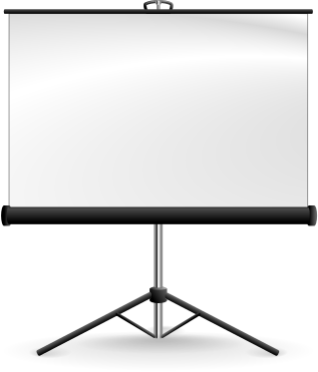

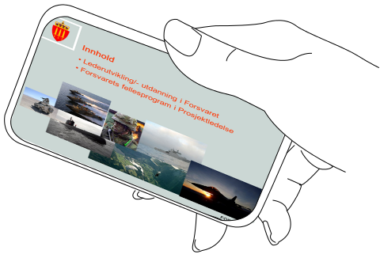

Slide 3
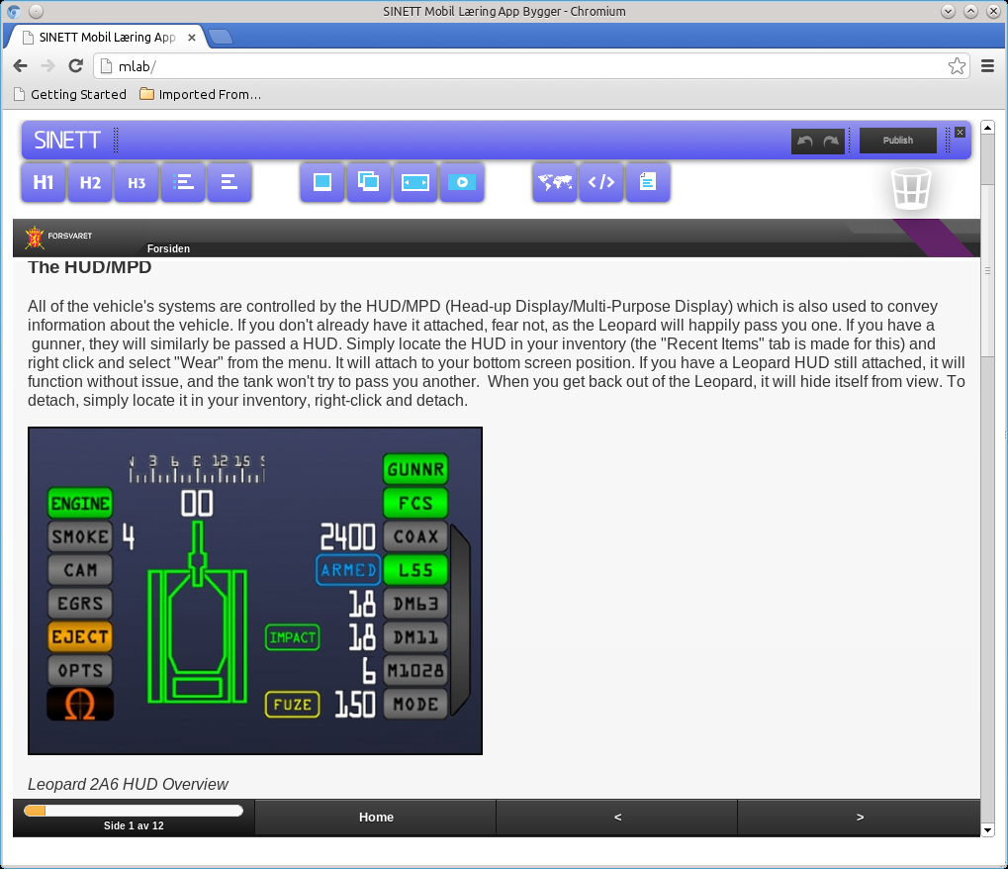
Demo

Slide 4
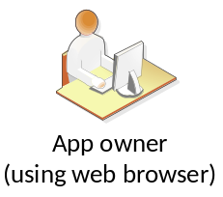


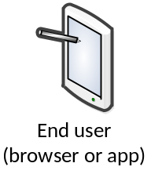
Work flow to build and deploy an app
Administration
Create app
Copy app
Edit app
Delete app
Test app
Authenticate builders
Store templates
Store app
Compile app
Send to app “market”
Authenticate end users
Backend for "market app"
Web based market
Alert users about updates
Search for apps
Browse apps
Install apps

